Slide 1

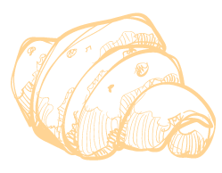
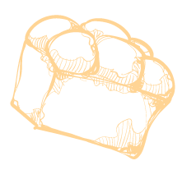

The Breadboard Bakery
SYD366NEE Assignment
Individual Component
Luca Novello

Slide 2
Introduction
Tasks:
Design a customer-facing website for Victoria’s Breadboard Bakery.
Add a add one more functionality to the website.
Create a Class diagram with the required classes.
Create a mockup of the new functionality.
A brief report on why you have chosen to add this feature to the website.

Slide 3
01
Class Diagram

Slide 4
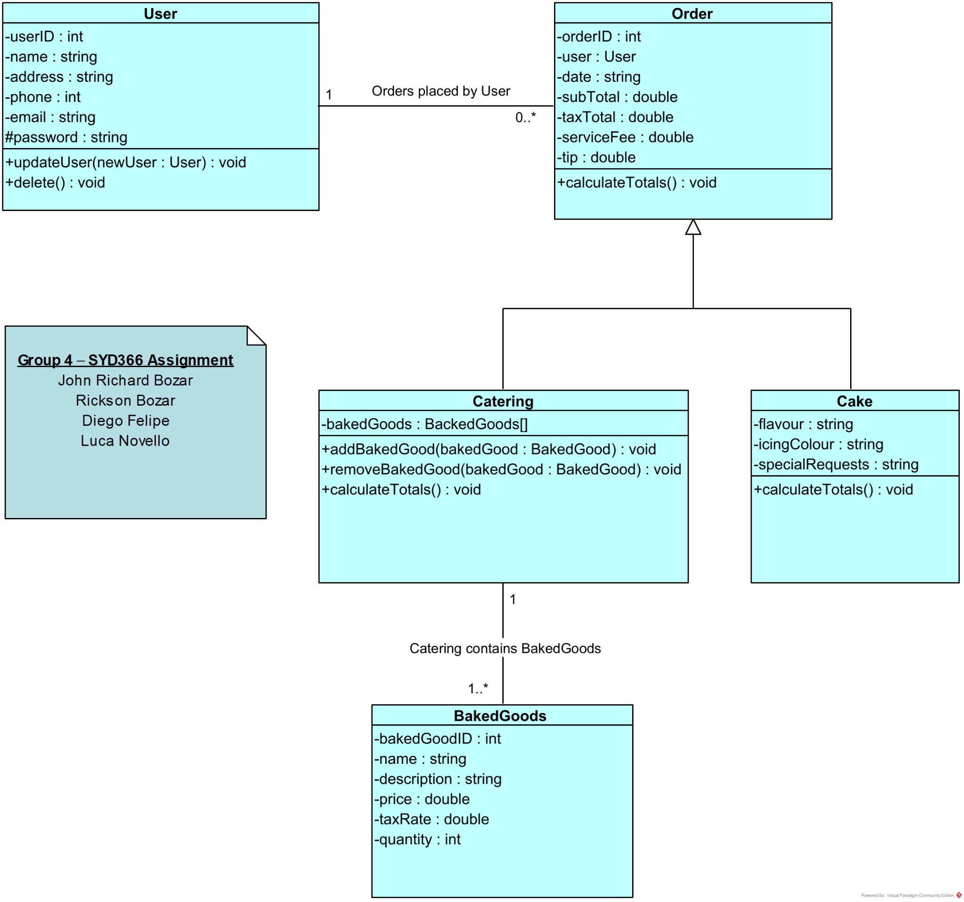
Class Diagram

Slide 5
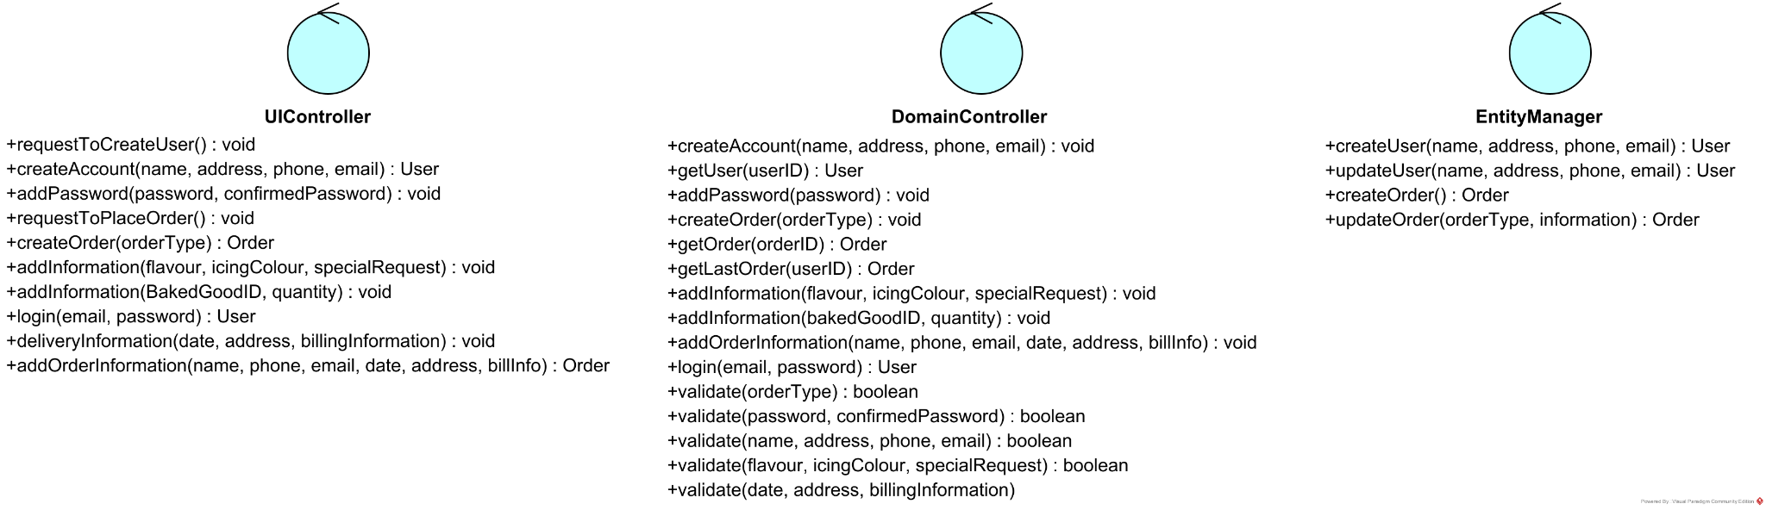
Controller Class Diagram

Slide 6
02
Repeat Last Order

Slide 7
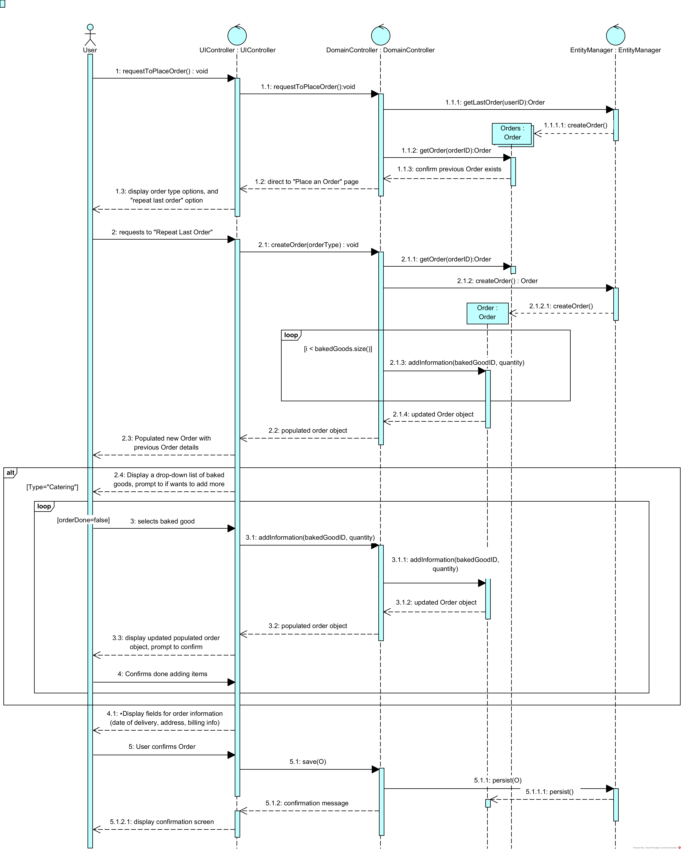

Sequence Diagram: Repeat Last Order

Slide 8
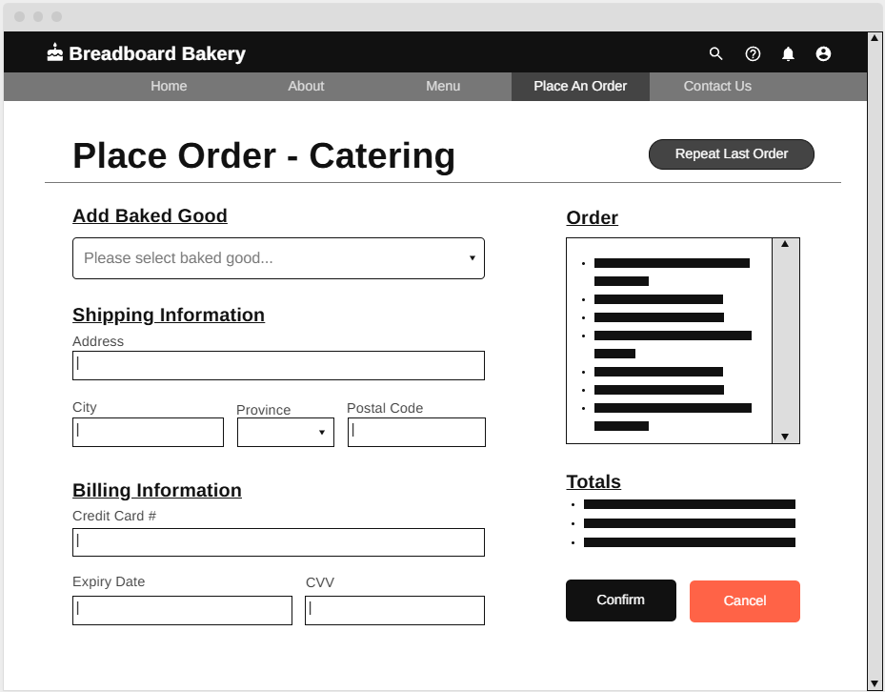
Mockup: Repeat Last Order

Slide 9




Additional Functionality
For the additional functionality to Victoria’s Breadboard Bakery website, I chose to add a “Repeat Last Order” function that allows the customer to place a new order with the same items from their previous. This can be useful for customers that make repeat orders and could help users streamline customer order process.

